Slide 1
Web Application
Using Django
Part V

Slide 2
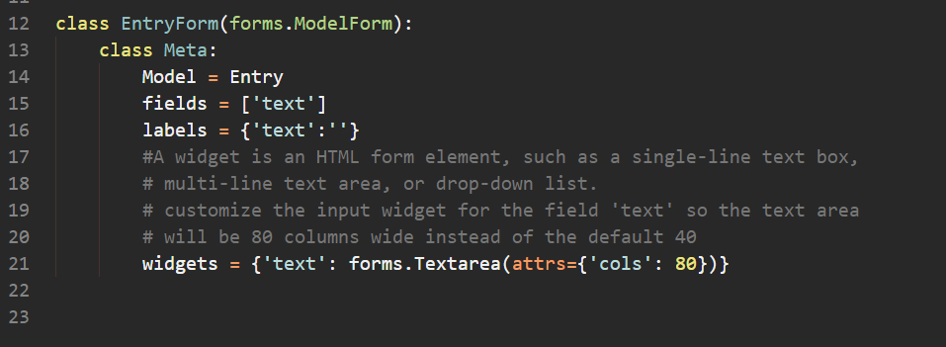
Create the form

Slide 3
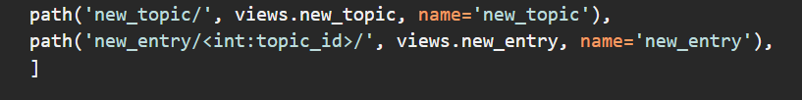
Define the URL

Slide 4
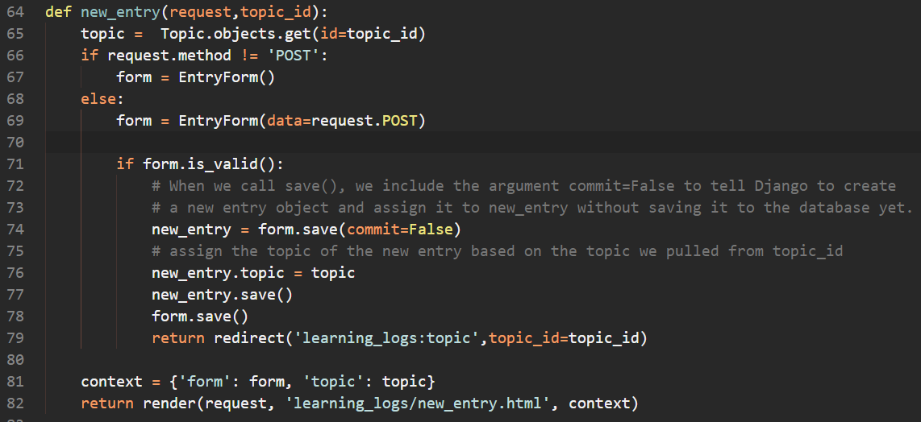
Define the Function

Slide 5
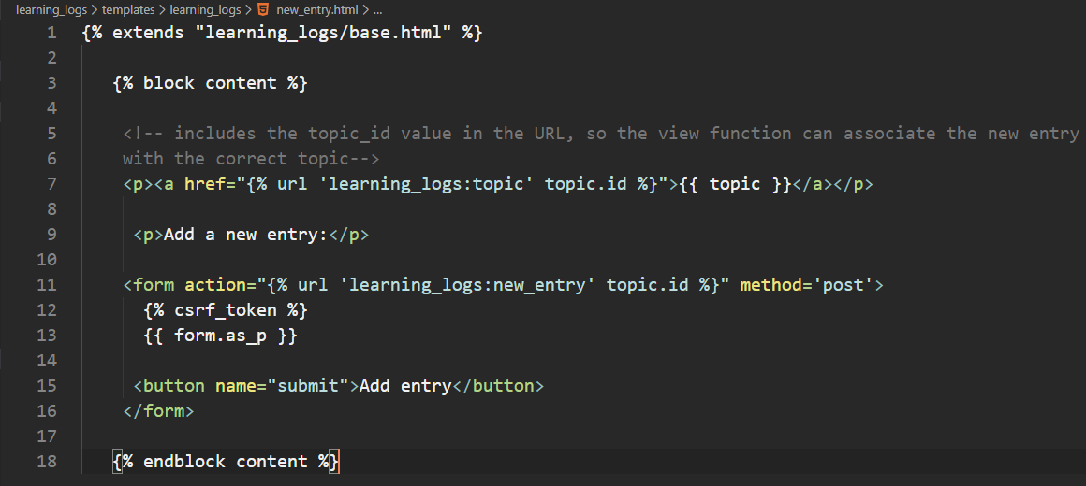
Define the Template

Slide 6
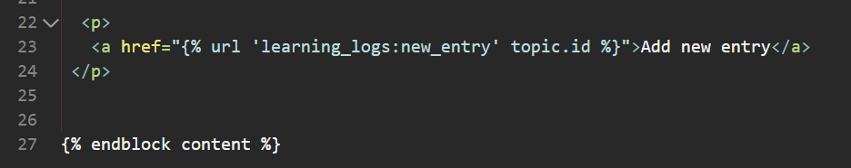
Linking to the new_entry Page
we need to include a link to the new_entry page from each topic page in the topic template:

Slide 7
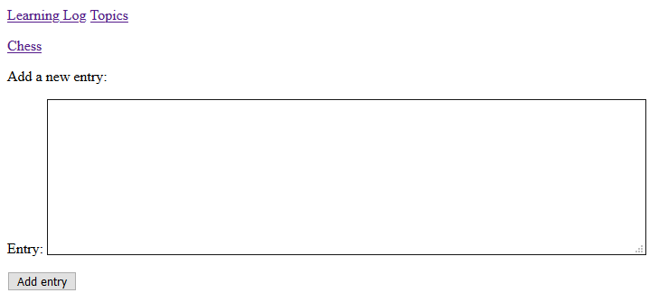
New Entry

Slide 8
Editing Entries
The edit_entry URL
The edit_entry() View Function
The edit_entry Template
Linking to the edit_entry Page
Notes:
New feature:
Create a url, learning_logs urls
Make a view, communicating back and forth between the website and the database.
Make the template, html portion
Link the new edit entry to each entry
____________________________________________________
Model is adding a new attribute to the website, like adding a new comment.
Migrate my changes to make it be effective. Better to plan in advance.
Spend time thinking about what do I need to include in my model to make it effective.
Output not listed on the slides, look at the project

Slide 9

The edit_entry URL

Slide 10

The edit_entry() View Function

Slide 11
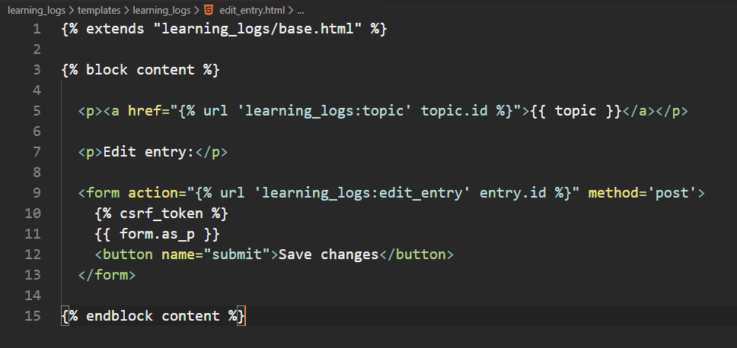
The edit_entry Template

Slide 12
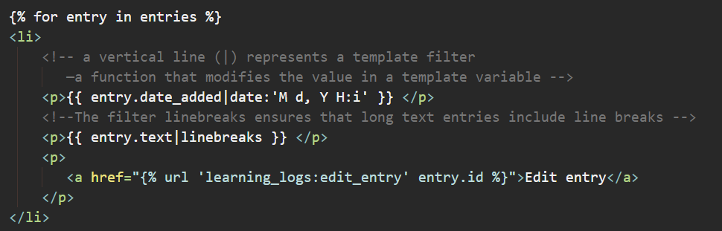
Linking to the edit_entry Page
Notes:
We make the change in topic.html

Slide 13
Setting Up User Accounts
set up a user registration and authorization system so people can register an account and log in and out.
create a new app to contain all the functionality related to working with users.
use the default user authentication system included with Django to do as much of the work as possible.
modify the Topic model slightly so every topic belongs to a certain user.

Slide 14

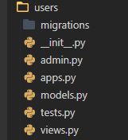
Setting Up User Accounts
Create a new app called users
It should create a file structure similar to learning_logs

Slide 15
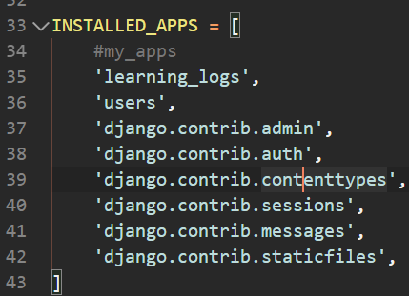
Setting Up User Accounts
Add the new app to the settings.py file so it is included in the project

Slide 16
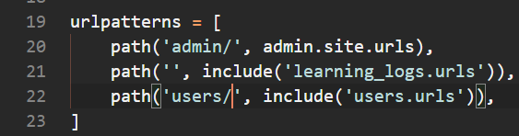
Setting Up User Accounts
Including the URLs from users
modify the root urls.py file to point to the urls.py file in the users app
This will include any URL that starts with the word users.
such as http://localhost:8000/users/login/

Slide 17
The Login Page
Make a new urls.py file in the directory learning_log/users/
Use the default login view that comes with Django
default URLs include named URL patterns, such as 'login' and 'logout’
The login page’s pattern matches the URL http://localhost:8000/users/login/
When Django reads this URL, the word users tells Django to look in users/urls.py, and login tells it to send requests to Django’s default login view.

Slide 18
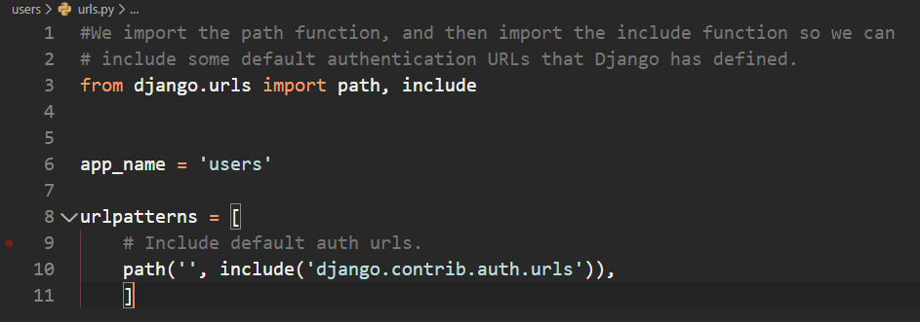
The Login URL

Slide 19
The Login Template
No need for a view since we will use Django’s default view function for the login
we still need to provide a template for the page
The default authentication views look for templates inside a folder called registration
Inside the learning_log/users/ directory, make a directory called templates; inside that, make another directory called registration
Create a file called login.html inside the registration folder

Slide 20
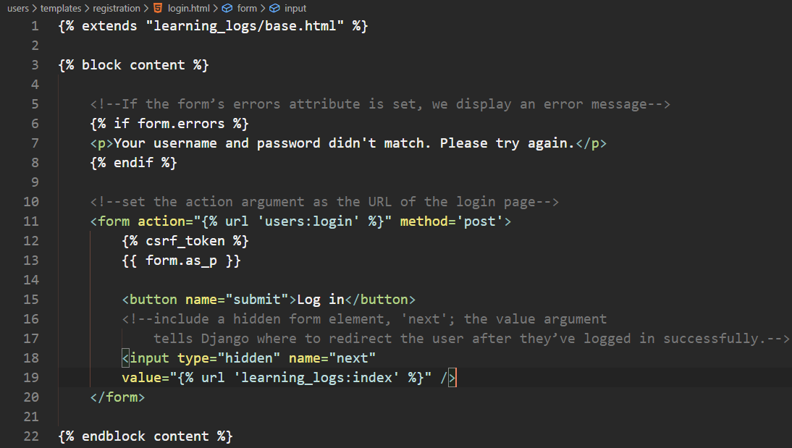
The Login Template

Slide 21
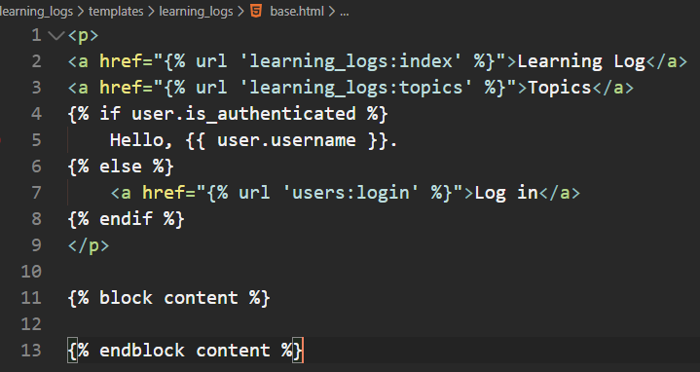
Linking to the Login Page
add the login link to base.html so it appears on every page
login link should only appear if user is not logged in so use if clause

Slide 22
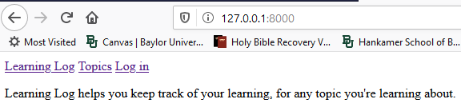
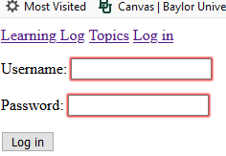
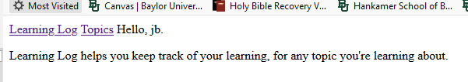
Test it out!
Log out as admin – go to the admin page and make sure you are logged out

Slide 23
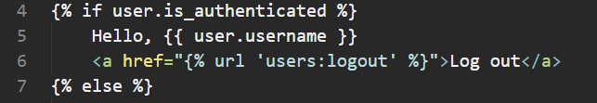
Logging Out
provide a way for users to log out
put a link in base.html that logs out users; when they click this link, they’ll go to a page confirming that they’ve been logged out

Slide 24
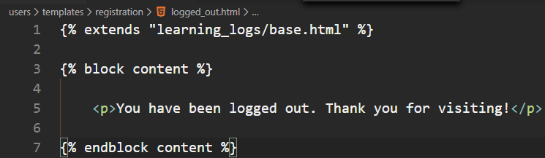
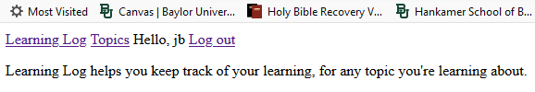

The Logout Confirmation Page
the default Django view will render a page called logged_out.html.
Create a file called logged_out.html in the same directory where you created login.html

Slide 25
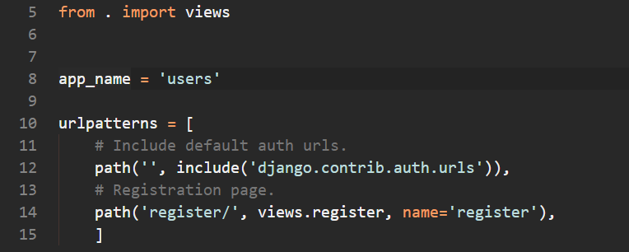
The Registration Page
use Django’s default UserCreationForm but write our own view function and template
add the URL to the urls.py file (don’t forget the import statement line 5)

Slide 26
The Registration Page
We will use Django’s default registration form, but we still need our own view and template
Based on the urls.py file, the function name will be register and it will resolve to the url - http://localhost:8000/users/register/

Slide 27
The register() View Function
The register() view function needs to display a blank registration form when the registration page is first requested
process completed registration forms when they’re submitted
If registration is successful, then the user should be automatically logged in

Slide 28
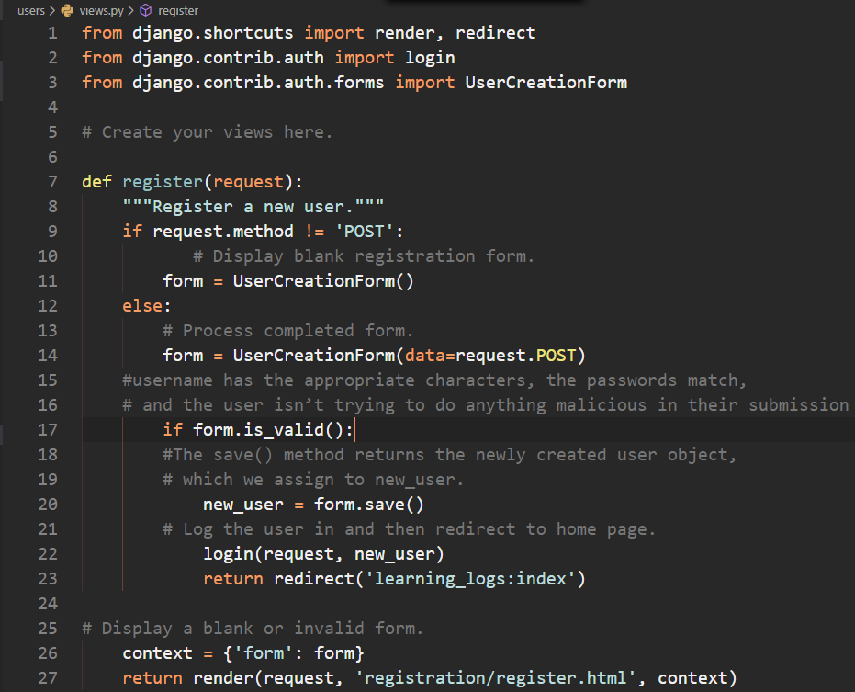
The register() View Function

Slide 29
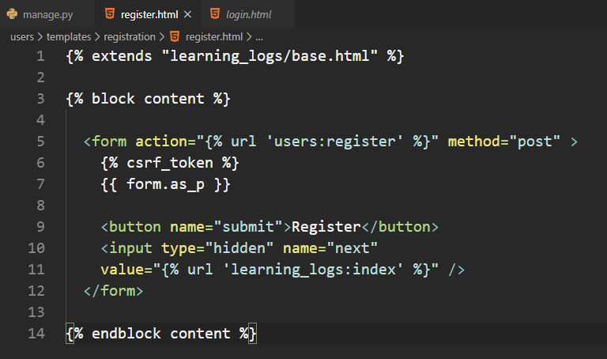
The register Template

Slide 30
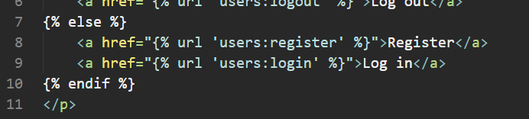
Linking to the Registration Page
show the registration page link to any user who isn’t currently logged in

Slide 31
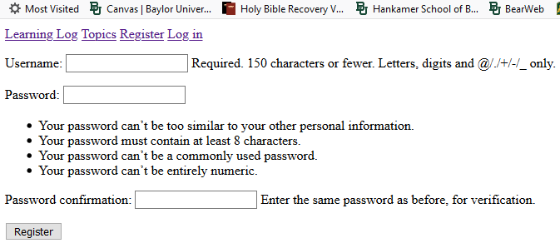
Test it out!

